Slide 1
Thesis Images

Slide 2
Introduction

Slide 3
1.3 – 1.5
Control Methods using Dynamics or Structure and Dynamics
Network Topology
Genes/Proteins/Molecules
Regulatory Edges sans Dynamics
Identify Control Targets
Multi-Omics Data
Literature Evidence
Experiments
Identify Successful Concerted Perturbations of Control Targets
Dynamical Model
System Dynamics
ODEs w/ Kinetic Parameters
Logic Formalisms
Simulate Using Model Dynamics
Identify Network
Attractors

Slide 4
1.5 - 1.7
Identify Successful Concerted Perturbations of Control Targets
Identify Control Targets
Estimate
Network
Attractors
Structure-based Control Methods
Algorithms Such as SFA
1.3 – 1.5
Control Methods using Dynamics or Structure and Dynamics
Network Topology
Genes/Proteins/Molecules
Regulatory Edges sans Dynamics
Identify Control Targets
Multi-Omics Data
Literature Evidence
Experiments
Identify Successful Concerted Perturbations of Control Targets
Dynamical Model
System Dynamics
ODEs w/ Kinetic Parameters
Logic Formalisms
Simulate Using Model Dynamics
Identify Network
Attractors

Slide 5
Identify Control Targets
Estimate
System Attractors
Structure-based Control Methods
Algorithms Such as SFA
Network Topology
Genes/Proteins/Molecules
Regulatory Edges sans Dynamics
Control Methods using Dynamics or Structure and Dynamics
Identify Control Targets
Multi-Omics Data
Literature Evidence
Experiments
Dynamical Model
System Dynamics
ODEs w/ Kinetic Parameters
Logic Formalisms
Simulate Using Model Dynamics
Identify System Attractors

Slide 6
(b)
Network Topology
Genes/Proteins/Molecules
Regulatory Edges without Dynamics
(e)
(a)
Control Methods using Dynamical Model
Control Targets
Multi-Omics Data
Literature Evidence
Experiments
(g)
Successful Concerted Perturbations of Control Targets
(d)
Dynamical Model
ODE Model
Boolean Model
Dynamical Systems Modeling
Virtual Screening
Bioinformatics Techniques
(c)
Simulate Dynamical Model
System Dynamics
ODEs with Kinetic Parameters
Logic Formalisms
(f)
System
Attractors

Slide 7
(b)
Network Topology
Genes/Proteins/Molecules
Regulatory Edges without Dynamics
(e)
Control Methods Using Network Structure
Control Targets
(a)
Control Methods using Dynamical Model
Multi-Omics Data
Literature Evidence
Experiments
(g)
Successful Concerted Perturbations of Control Targets
(d)
Dynamical Model
ODE Model
Boolean Model
Dynamical Systems Modeling
Virtual Screening
Bioinformatics Techniques
Simulate Using Network Topology and SFA
(c)
Simulate Dynamical Model
System Dynamics
ODEs with Kinetic Parameters
Logic Formalisms
(f)
System
Attractors

Slide 8
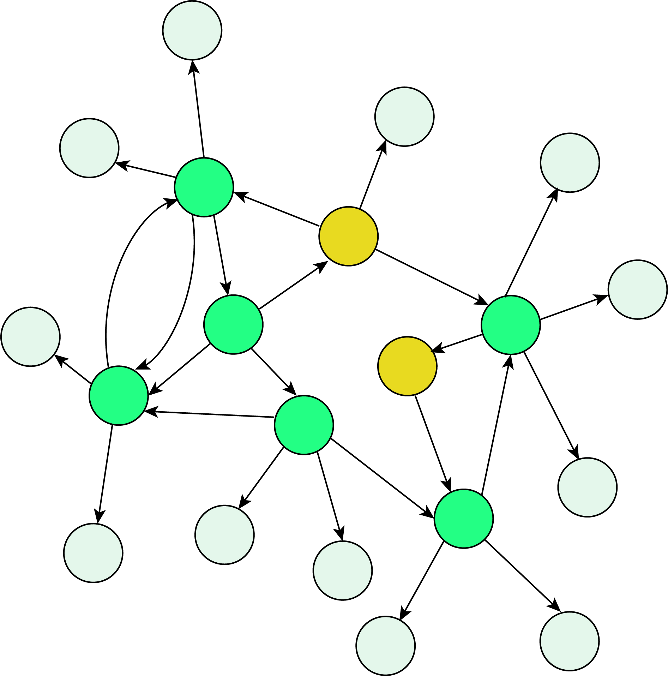
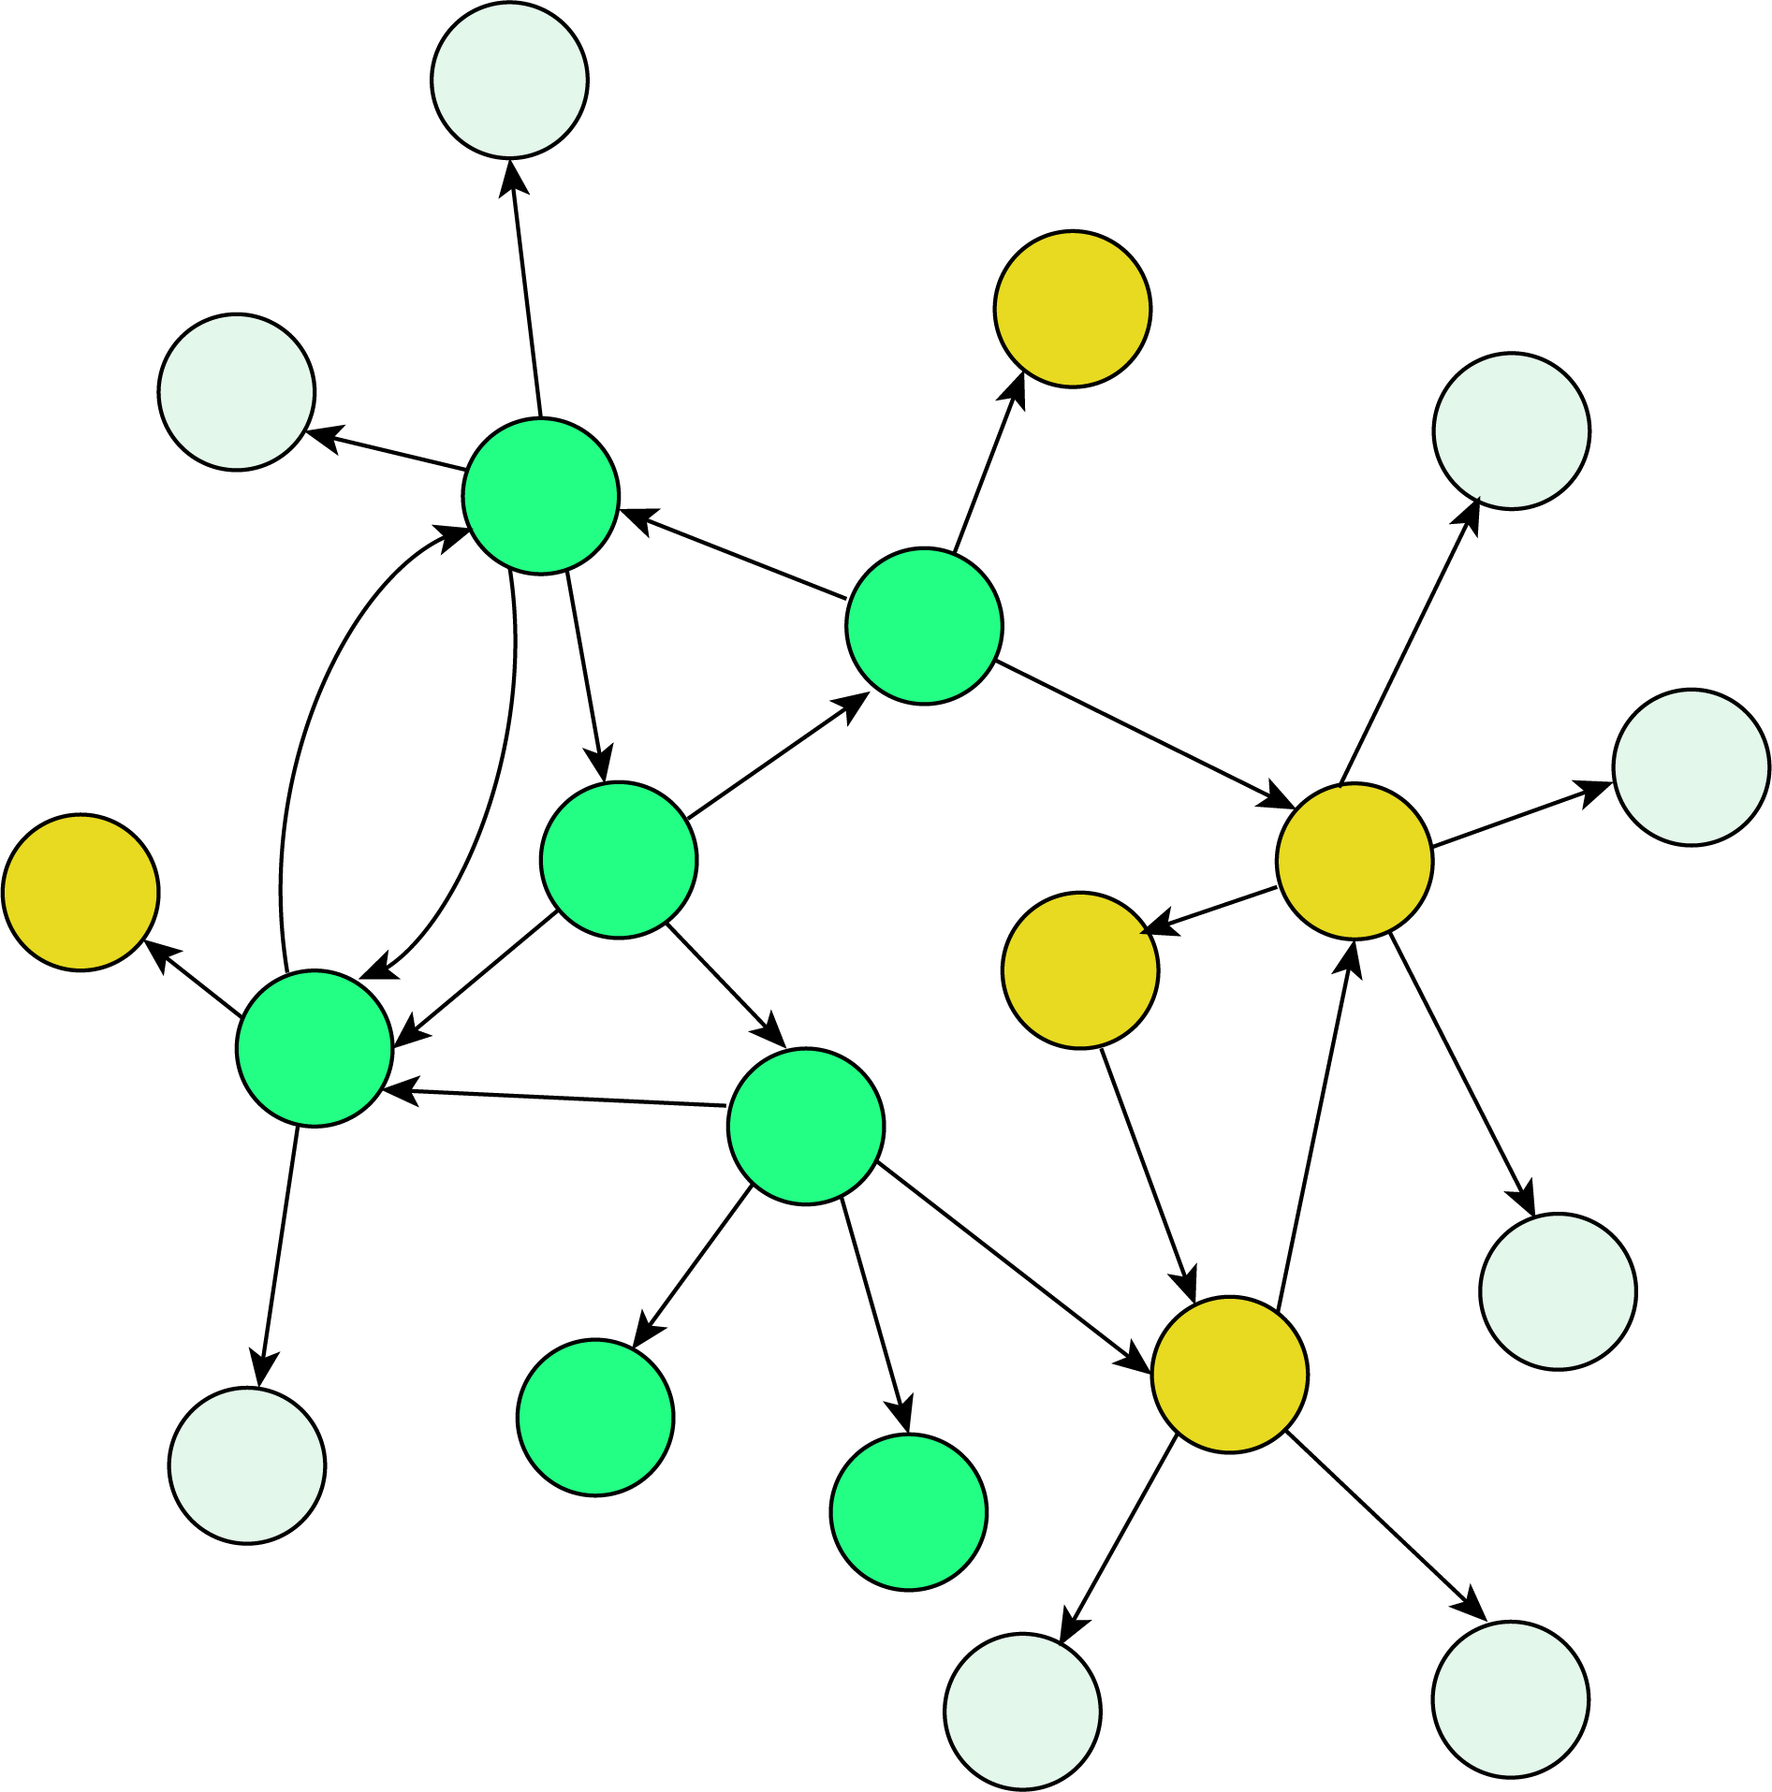
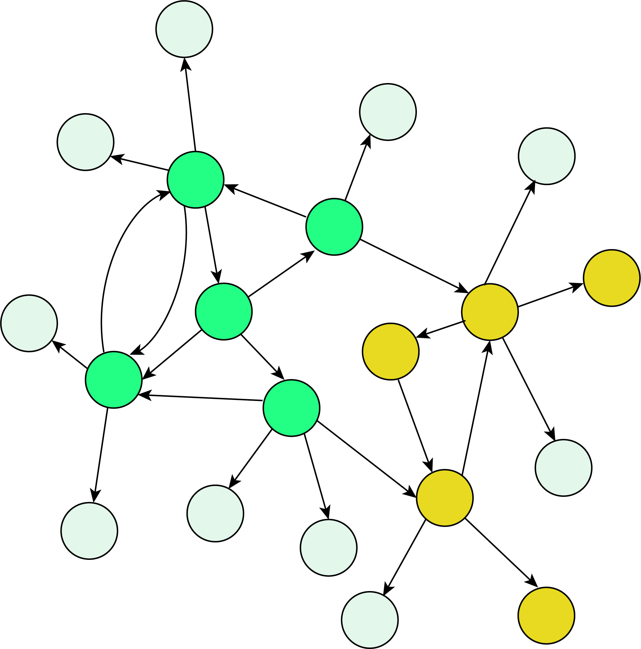
s(t₁)
State Space
s(t₂)
s(t₃)… s(t_{n-1})
s(t_{n})
Attractor State

Slide 9
State Space
s(t₁)
s(t₂)
s(t₃)… s(t_{n-1})
s(t_{n})
Attractor State

Slide 10
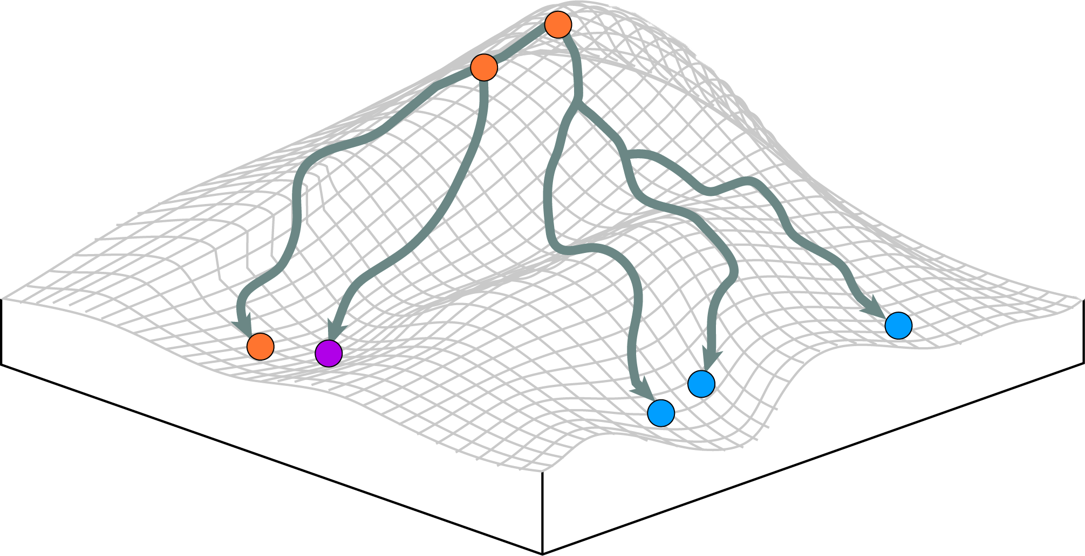
Unstable State
Initial State
“Potential” or stability of a state
Stable State = Mature Cell Type
Stable State =
Mature Cell Type
Stable State = Mature Cell Type

Slide 11
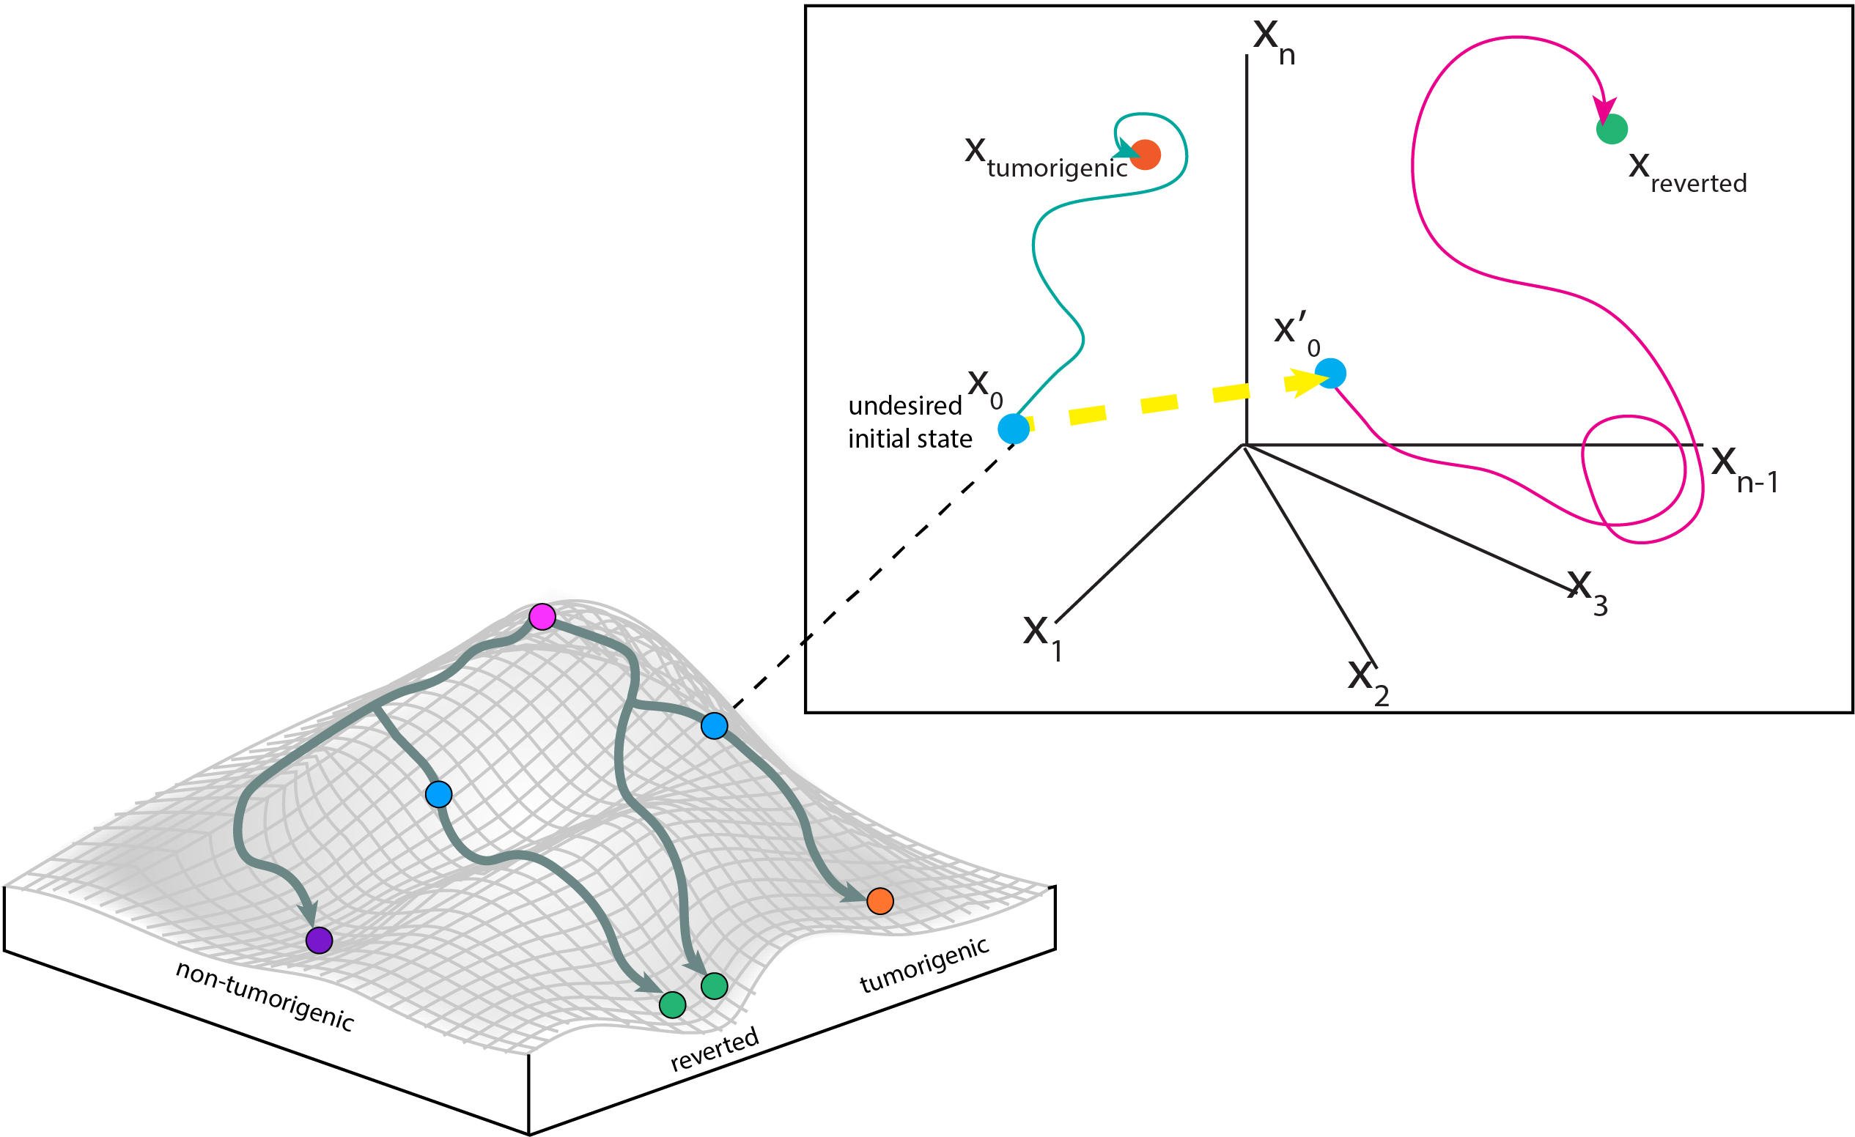

Slide 12
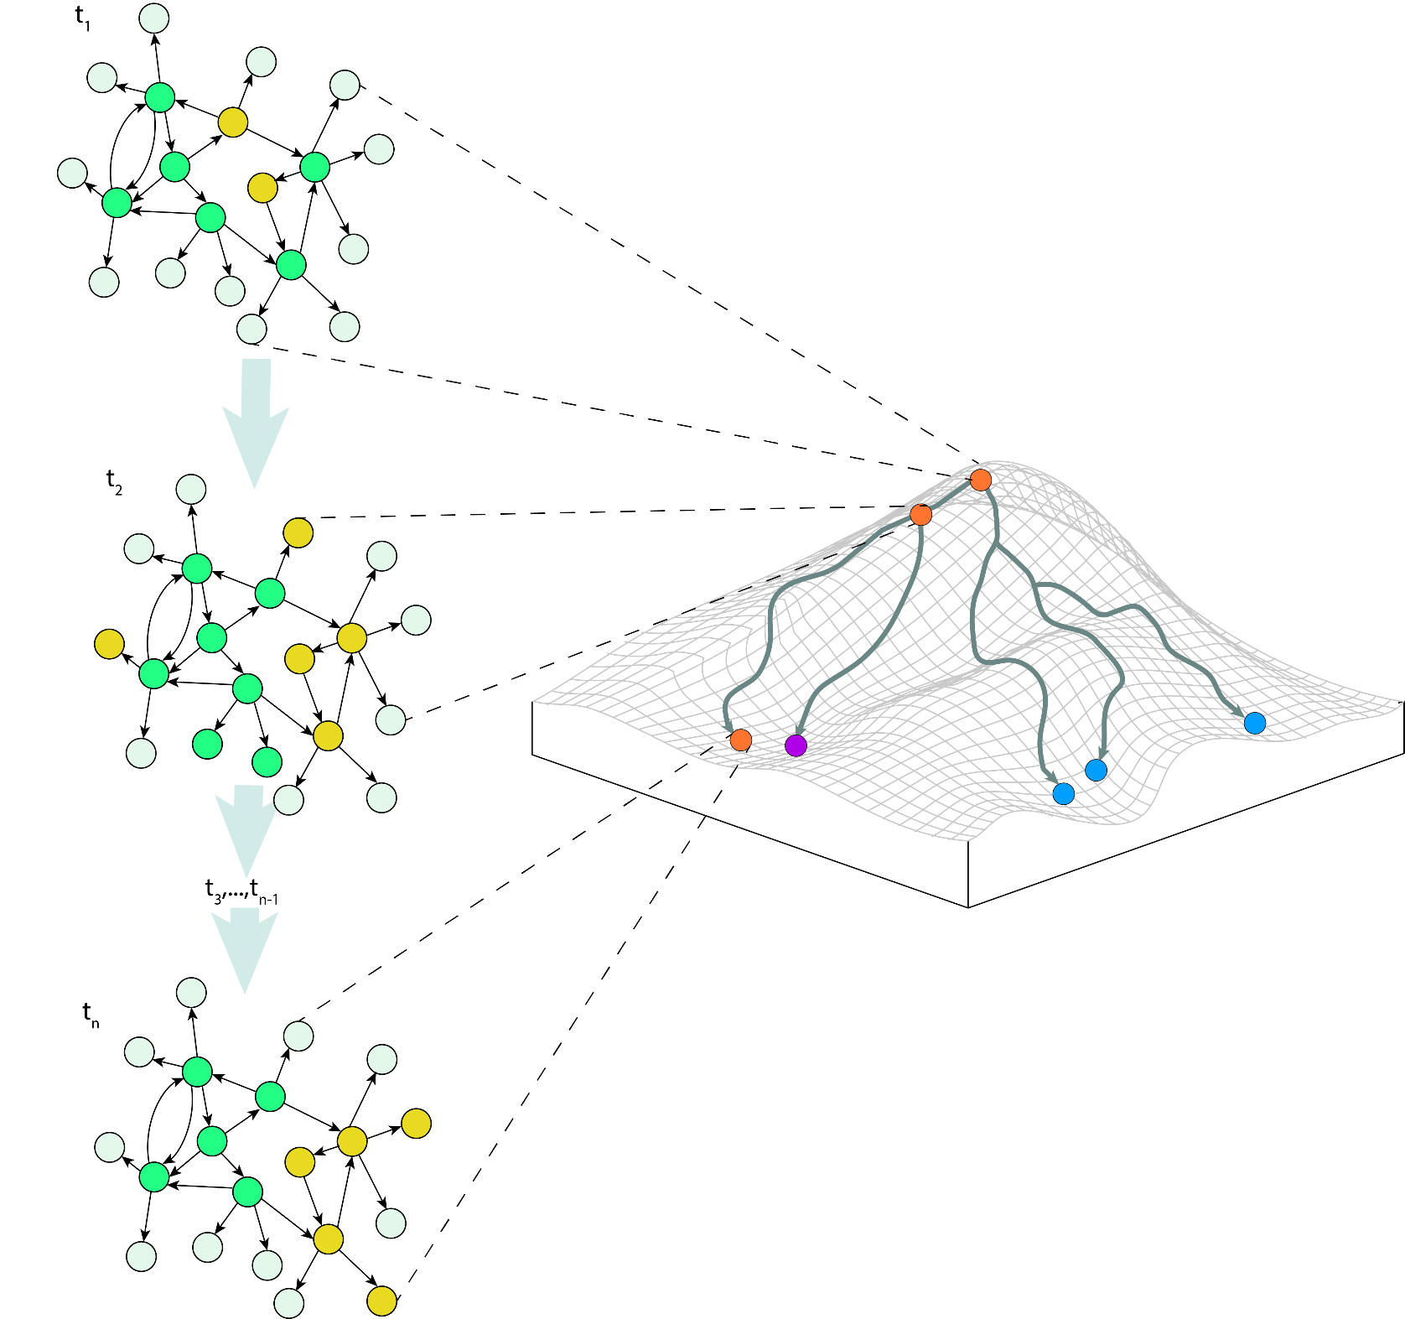

Slide 13
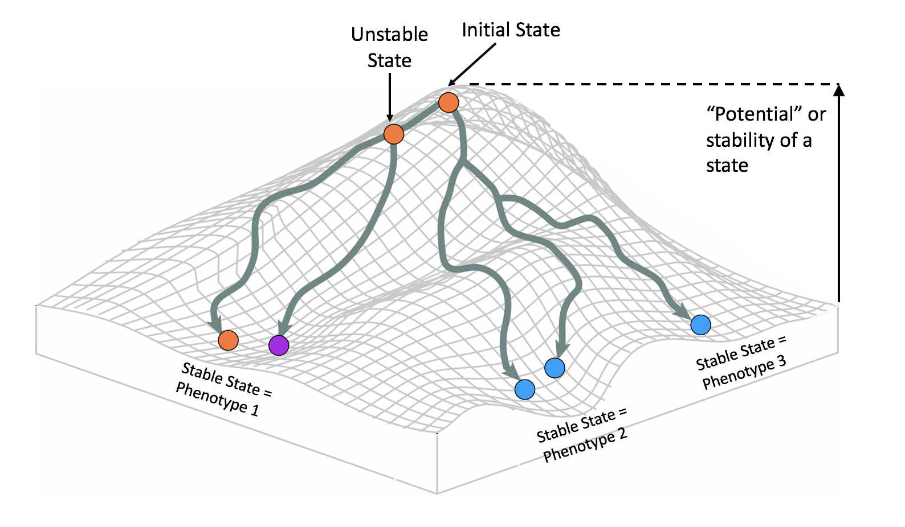

Slide 14
t₀
Initial State
Unstable State
t₁
“Potential” or stability of a state
t₂… t_{n-1}
Stable State = Phenotype 3
t_{n}
Stable State = Phenotype 1
Stable State = Phenotype 2

Slide 15
s(t₁)
Initial State
Unstable State
s(t₂)
Increase in
“Potential”
of a State
Increase in
Stability
of a State
s(t₃)… s(t_{n-1})
Attractor = Mature Cell Type
s(t_{n})
Attractor = Mature Cell Type
Attractor = Mature Cell Type

Slide 16
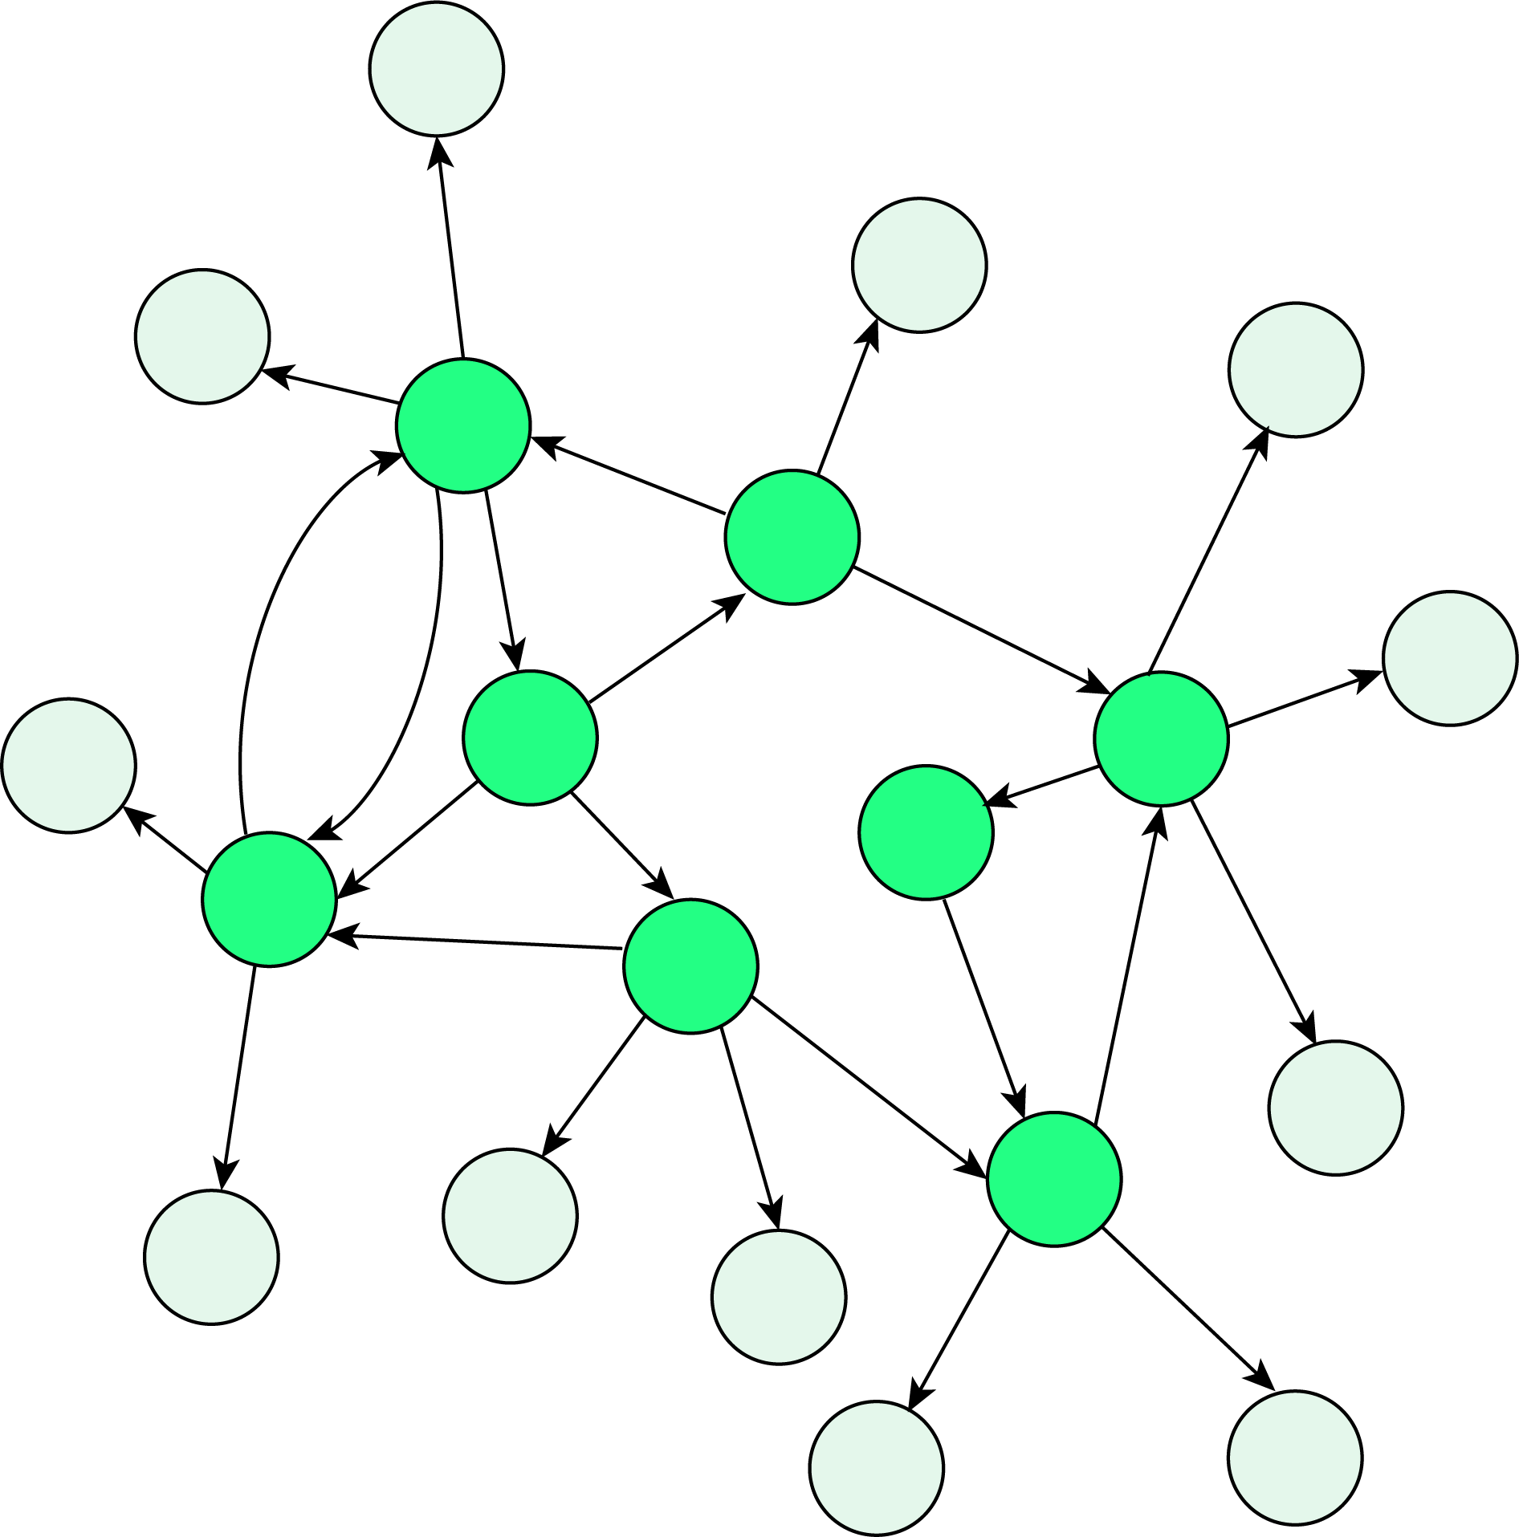

Slide 20
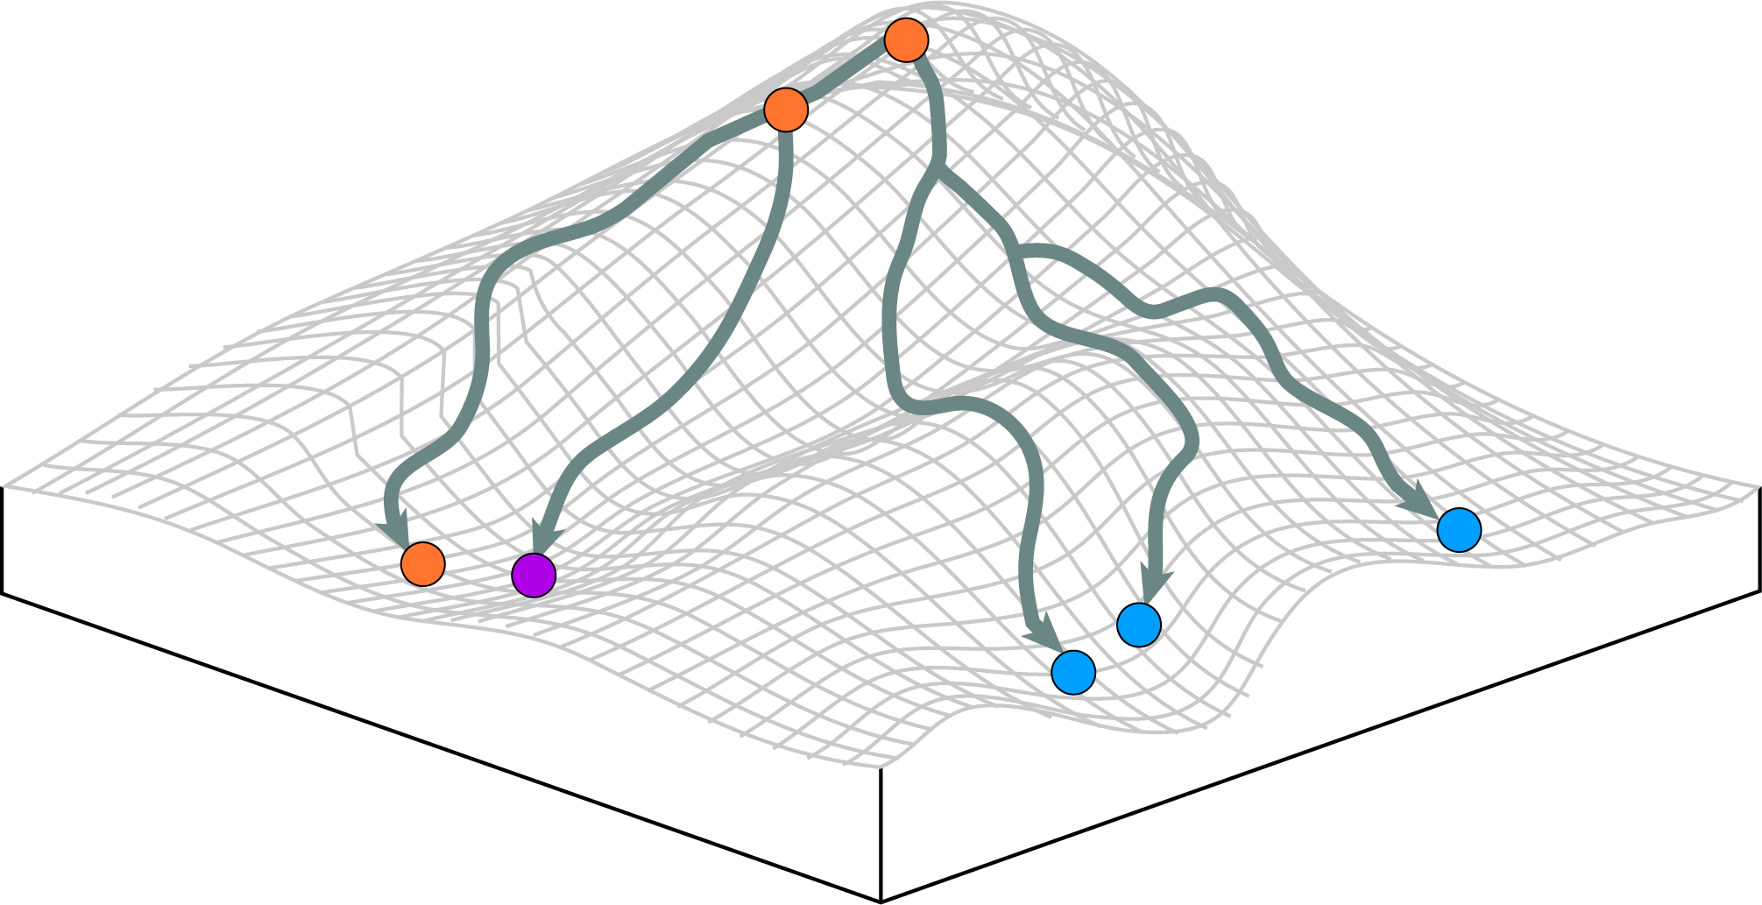

Slide 21
Methods

Slide 22
